Slide 1



Slide 2


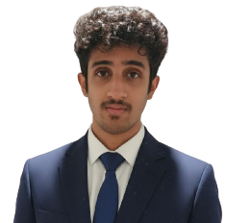
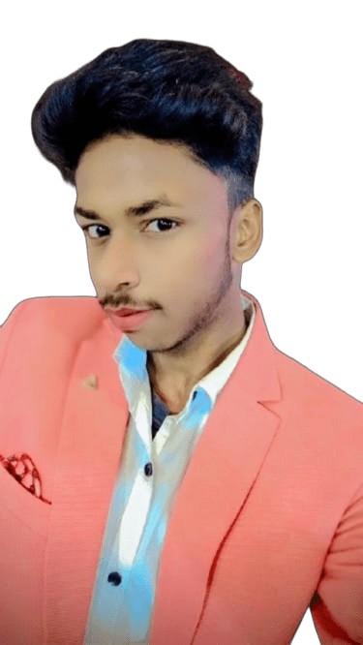
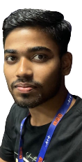
Agam Shani
alexpitt009@gmail.com
Nidhin R
r.nidhinofficial@gmail.com
Anmol Katiyar
anmolkatiyar084@gmail.com
Hritik
Kumarhritik030@gmail.com

Slide 3


Slide 4


Slide 5
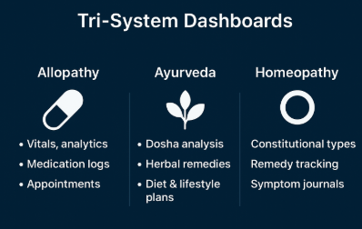

Slide 6


Slide 7


Slide 8


Slide 9
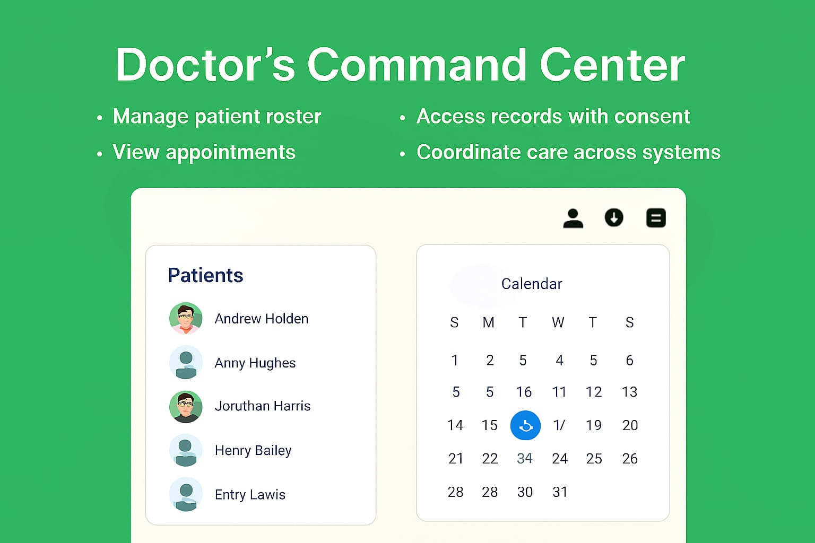

Slide 10


Slide 11


Slide 12


Slide 13

alexpitt009@gmail.com

